Slide 1
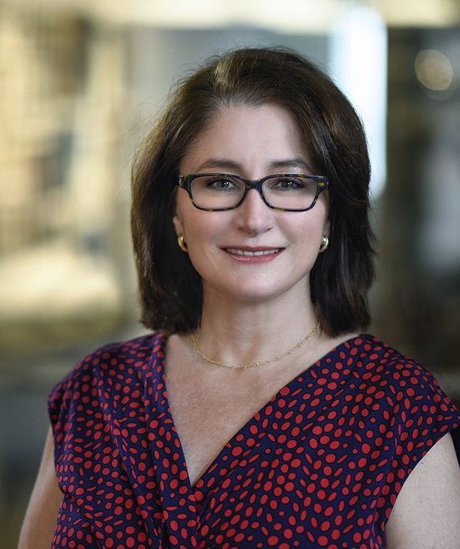
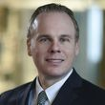
Research Opportunities at Baylor College of Medicine
Wednesday, September 18, 2019, 3:00-4:00pm, Sill 120
Laurie Connor, PhD
Assistant Professor
Director, Summer Undergraduate Research
Graduate School of Biomedical Sciences
Baylor College of Medicine
Robert Stephens, MNM
Associate Director of Recruiting/Admissions
Graduate School of Biomedical Sciences
Baylor College of Medicine

