Slide 1
An Innovative (and Free!) Program Model for Undergraduate Research Education
Stephanie Shiver
stephanie.shiver@utah.edu
University of Utah
07/01/2018
For presentation materials:
bit.ly/CUR2018researcheducation
Notes:
Hi. I’m Stephanie Shiver. Thank you so much for coming. I am going to talk about the program model for undergraduate research education that the Office of Undergraduate Research at the University of Utah has been hosting for a few years now. As an Advisor for the OUR, one of my tasks is organizing this series, which we call the Undergraduate Research Education Series or the URES – don’t worry the model is more innovative than the title. The Director of our office, Rachel Hayes-Harb, started this program in Spring 2015. I took over organizing it and we started tracking attendance and data in Summer 2015.

Slide 2
Motivation
Leverage our campus expertise
Fill in educational gaps for research students
- Professionalization
- Context/perspective
Notes:
-The motivation for this series is really to leverage the wide-spread expertise on our campus to the benefit of students. And to fill in educational gaps for research students. Either in terms of gaps that they have identified or in terms of pretty discipline generic information that most or all faculty mentors end up needing to provide to their mentees - that we can provide in a centralized way and help take that off of their plates so that they can focus more on technical training for their mentees. That includes professionalization topics and topics that help introduce students to the context of their work and a larger perspective for where their work fits into the world – topics that are important to the development of a well-rounded researcher/student.

Slide 3
All Undergraduate Research Education Series Topics
Academic Communication (presented by student in Undergraduate Research Leaders program)
Asking for Letters of Recommendation
Bennion Center Programs and Research
Citation Management Workshop
Creating Effective Research Posters
Data Management
Discipline-Specific Writing: Engineering
Discipline-Specific Writing: Fine Arts
Discipline-Specific Writing: Images in Science
Discipline-Specific Writing: Medicine
Discipline-Specific Writing: SBS
Discipline-Specific Writing: Science
Distinguished Scholarships
Doing Library Research Workshop
How to Get Good Mentorship (Panel)
How to Read a Research Article
How to Translate Your Research Into a Resume
How to Write a Personal Statement
Institutional Review Board
Lassonde Institute Research Programs
Leveraging Your Research Experience in Industry
Literature Reviews
People of Color in Research (organized by students in Undergraduate Research Leaders program)
Preparing for Graduate School
Preparing for Medical School
Public Speaking (presented by student in Undergraduate Research Leaders program)
Public Speaking - How to Present
Reflection as Part of the Research Process
Research Reproducibility
Responsible Conduct of Research
Technology & Venture Commercialization
The Science of Science Communication
Top 10 Library Research Tips
Translating Your Research to a General Audience
Women in Research Panel (organized by students in Undergraduate Research Leaders program)
Writing an Abstract
Writing Workshop
Notes:
-[In the presentation materials, I included a list of the events in the Series this semester as well as a full list of topics that we have hosted over the last few years. And I am happy to talk more about those topics later, if you are interested.]

Slide 4
Motivation
Leverage our campus expertise
Fill in educational gaps for research students
- Professionalization
- Context/perspective
Low barrier events
- Wide application
- Open to all
Notes:
-When designing this program, we really wanted it to be low barrier. The topics need to have pretty wide application and serve students across disciplines at all stages in their research and the events are free and open to anyone on campus. They are specifically designed for undergraduate students, but they are open to the public and we have had a few graduate students drop in as well.
This series is, it seems, filling an educational need on campus and providing high-quality resources to students that they did not have this sort of ease of access to previously. The attendances, range pretty widely from 5 to 80 students for each event, and have grown each year, including growth in attendances from students not in our programs. The number of events have also grown from 7 in my first semester organizing the series to 11 in Summer and 14-15 in Fall and Spring semesters. I now have too many really good topics (you’ll see 37 distinct titles on that handout) to cycle through them all each semester and we trade off, depending on faculty load and application to immediate events (i.e. presentations in the Spring).

Slide 5
Design
One event/(programmable) week
1 – 1.5 hour seminar or workshop
Held in the same room throughout the semester
Facilitated by faculty or other campus experts
Required attendances for several programs
Open to anyone
Advertising
Notes:
So then let’s talk about the design of the program and then get more into assessment and numbers.
-We host one event a programmable week each semester – so, not the first week of classes or during finals and not during spring or fall breaks.
-Each event is one hour to an hour and half, depending on the format of the topic and the depth people have requested for that topic. [Sometimes we’ll have hosted an introduction to a topic and students ask for more content, more depth, so we will offer a longer session on the same topic in a later semester.]
-The events are held in the same room throughout the semester. Having all of the events in the same location is a benefit, when it is possible, so that students do not have to navigate our large campus to a new location each time. It just reduces confusion. I also think having it in a non-discipline specific building helps with optics. Students are less likely to feel underserved or like their discipline doesn’t matter as much, when the events are all in the Library or some building that isn’t generally designated for one type of coursework or research.
-Each event is presented or facilitated by a faculty member, or another campus expert – we have a few librarians who host sessions for us, based on their specific expertise (data management, reproducibility). We also have hosted a few panels. Several of the panels are of faculty members, one is of local employers who are invited by the Career and Professional Development Center on campus and I moderate the session.
This feature of the URES does a couple good things for the office (in addition to giving students direct access to expertise/experts they might not otherwise have access to)– we have been able to build more partnerships across campus or have strengthened our relationships with departments and resource centers through these events. [CUR always has sessions about bolstering on campus partnerships. This is a great way to do that. Including campus resources that are directly applicable to our students in the series encourages more regular communication between our offices, reinforces the importance of those resources, and helps those offices’ with their outreach numbers.] And this is what keeps the events series free. We aren’t hiring outside resources for the events. By keeping the event series centered around what we already have available on campus – personnel or knowledge – we are leveraging our strengths for very little cost.
-The events in the series also fulfill requirements for several programs, including a few of these partnerships that we have been strengthening. URES events fulfill requirements for UROP, SPUR, the Honors College Thesis Writing Community, and the Transfer Honors Society.
All of these programs require a different number of attendances, but these partnerships have directly contributed to the URES attendances that we will look at a bit later.
-The URES events are all open to anyone. We don’t turn anyone away until we reach fire code capacity, which has only happened a few times.

Slide 6
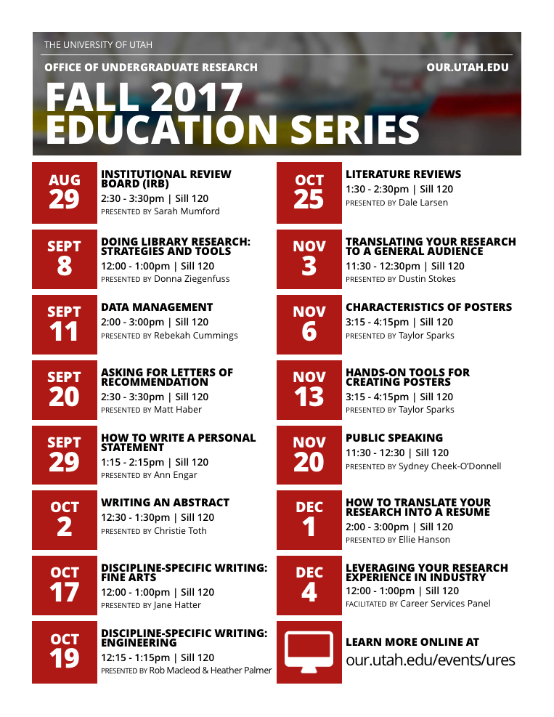
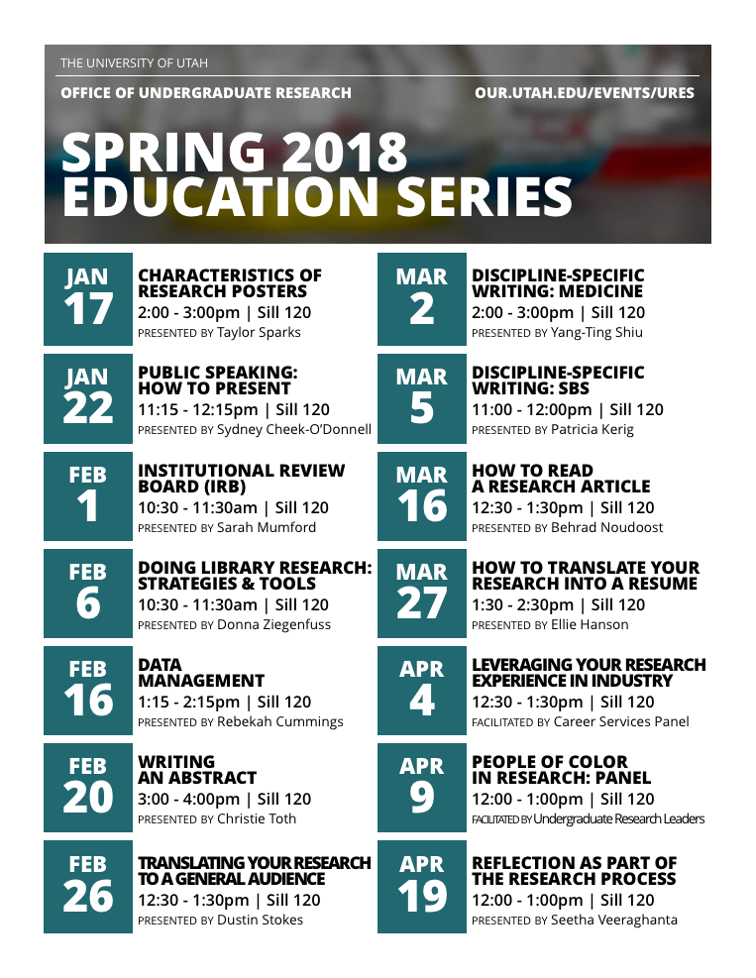
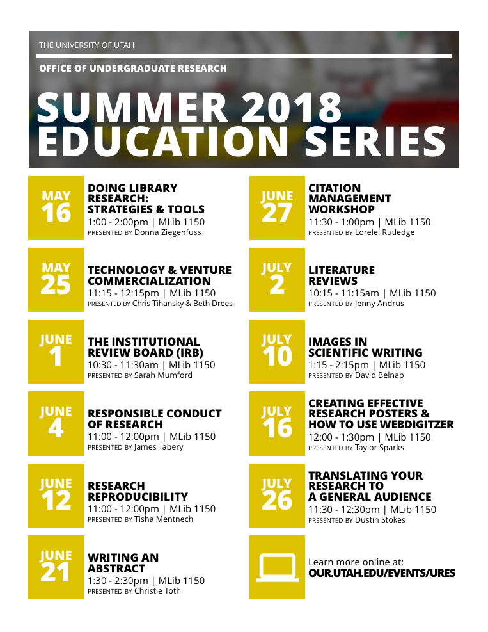
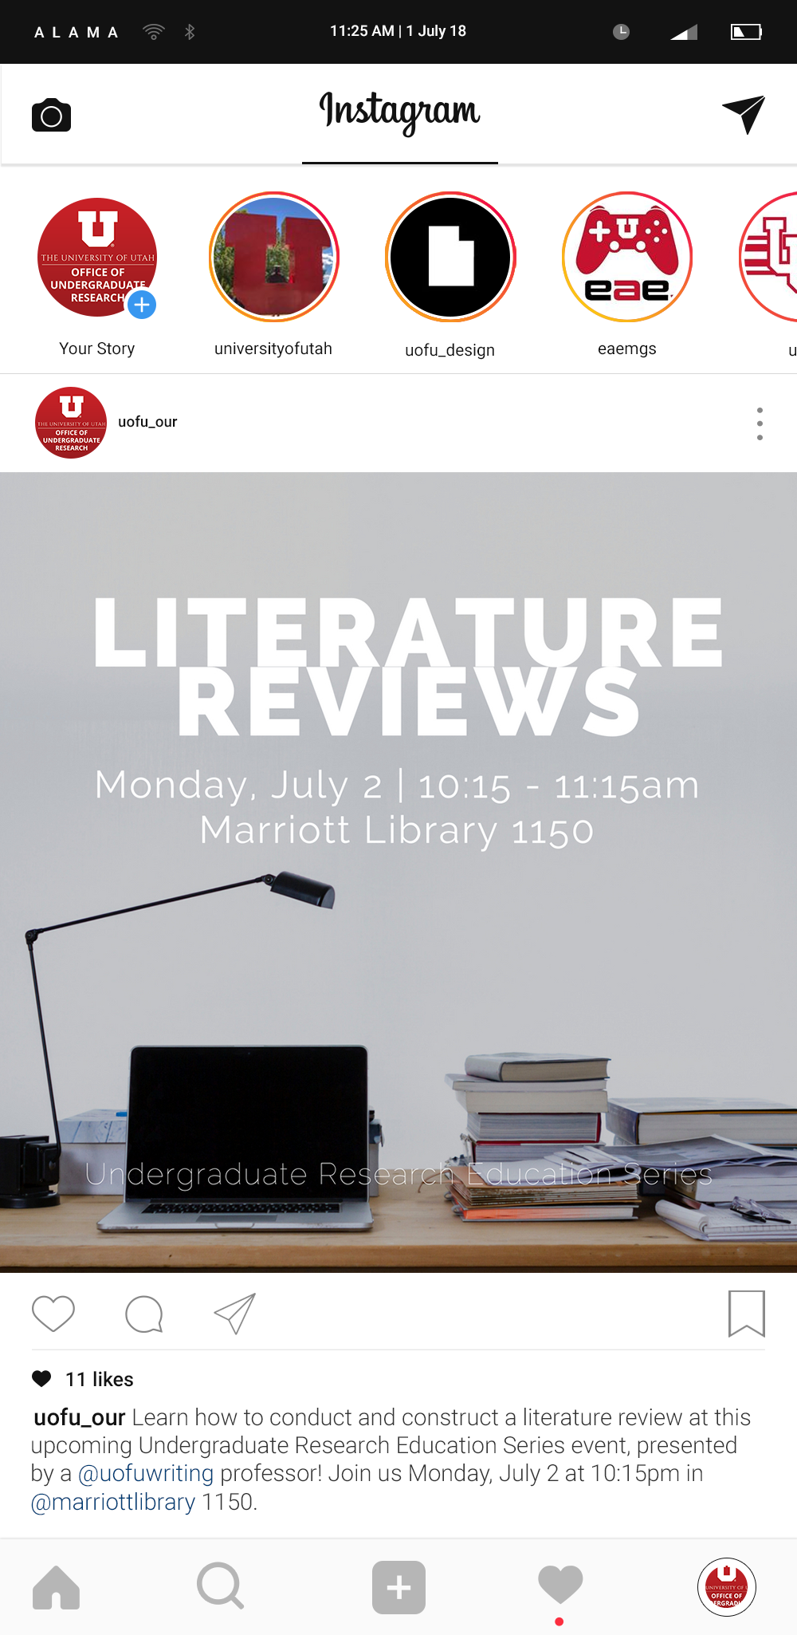
Notes:
We advertise for the series in a variety of ways – we have a flier, again that is included in the presentation materials, if you are interested in the design, the series is posted on our online calendar, we send reminder emails for each event to our student listserve and faculty listerve, and we are working on improving our social media game and post the events on Instagram. I also remind the campus Advising community about the events every semester once the schedule is complete

Slide 7
Assessment
Online sign-in form
Notes:
-Ok. So that is what the series looks like. Now I want to tell you a bit about how we track attendances and the overall success of the program.
-We have an online sign-in form, we use Formstack, which we love, but you could use whatever online form system you prefer for this. I included a screen shot of our sign-in form, in the presentation materials. It is simple, I only ask for exactly what I need to track. We have an office Ipad that I pull this form up on and then pass around the room at each event. And I remind everyone in the room to sign in about a million times each event.

Slide 8
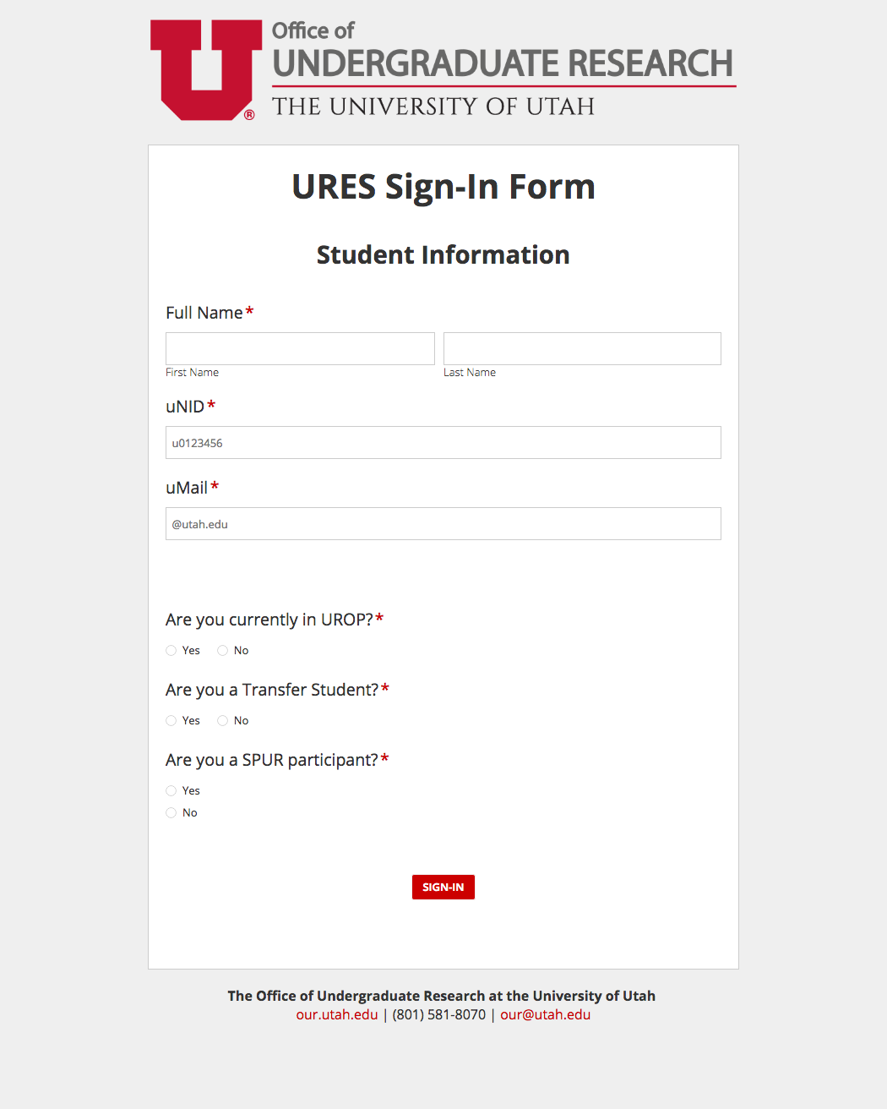
Notes:
I included a screen shot of our sign-in form, in the presentation materials. It is simple, I only ask for exactly what I need to track. We have an office Ipad that I pull this form up on and then pass around the room at each event. And I remind everyone in the room to sign in about a million times each event.
-You can see from that form, I track attendances for those partnerships I mentioned before. I send them a spreadsheet with the student info for their programs at the end of each semester, which is minimal work for me and no work for them, so a win-win, really. The Honors College programming is the exception for this. Their stuff overlaps with everything on campus in such a way that they feel it more helpful for me to just send all of the sign-in info over and they sort it on their own, which is even less work for me, so that is great.

Slide 9
Assessment
Online sign-in form
Ipad passed around the room at each event
Track attendances for several programs around campus
(Optional) evaluation for every event
Notes:
-At every event, I distribute an optional evaluation for the event. It is also really simple (it is the last bit in the presentation materials). I ask students to indicate which event they are attending, whether they would recommend that event to another student, and why or why not. The return rate is all over the place so that doesn’t give you any useful information, but this evaluation gets us some anonymous qualitative feedback about the sessions that helps me plan the future semesters of the series. [So if, 5 out of 12 responses thought the session was too basic, I ask the facilitator to kick it up a bit; or if 30 out of 33 thought it was really helpful, I will make sure to schedule that session regularly.]

Slide 10
Office of Undergraduate Research Undergraduate Research Education Series Evaluation Form
Which URES session are you attending?
_____________________________________________________________________ Would you recommend this URES session to another student?
YES NO
Why/Why not?
_____________________________________________________________________ _____________________________________________________________________ _____________________________________________________________________ _____________________________________________________________________ _____________________________________________________________________ _____________________________________________________________________ _____________________________________________________________________
Notes:
-At every event, I distribute an optional evaluation for the event. It is also really simple (it is the last bit in the presentation materials). I ask students to indicate which event they are attending, whether they would recommend that event to another student, and why or why not. The return rate is all over the place so that doesn’t give you any useful information, but this evaluation gets us some anonymous qualitative feedback about the sessions that helps me plan the future semesters of the series. [So if, 5 out of 12 responses thought the session was too basic, I ask the facilitator to kick it up a bit; or if 30 out of 33 thought it was really helpful, I will make sure to schedule that session regularly.]

Slide 11
Assessment
Online sign-in form - Ipad passed around the room at each event
Track attendances for several programs around campus
(Optional) evaluation for every event
- Sent to facilitators and tracked over time for RPT considerations
Final Report for our funded programs
Notes:
I also track this evaluation information. I send the number of attendances, number of evaluations, and positive evaluations, with some representative quotes from the evaluation sheets to each facilitator after their session. And I provide this information as sort of a package of documentation of service, when any facilitator is going up for RPT and would benefit from having that information on hand. I have also written a letter of support for a facilitator’s RPT consideration based on their service through the URES. So if you are thinking, this is great, it is free to the office, its free to students, but it requires time from the presenters/facilitators – how do I convince them that it is worth it to them – that is how. I provide whatever reporting would be useful to the folks I am asking to present/facilitate, or otherwise partner with the program. For faculty beyond RPT, the overall benefit of having some centralized research education, seems to be pretty convincing. They put in an hour-long presentation, but don’t have to re-hash the same topic 6 times with their own students, every semester, or talk about every topic in the series with every student. The benefit seems to pretty far outweigh the cost of facilitating.
-In terms of qualitative feedback, we also gather information from students via what we call the Final Report for our other funded programs. At the end of their participation, we ask that they fill out a form that measures our learning outcomes and prompts them for some open-ended qualitative feedback. The URES gets mentioned in that report, and I use that information to revise future semesters of the URES.
-We don’t currently collect feedback from faculty presenters/facilitators. We talk with them each semester, but I haven’t formally collected that information yet.

Slide 12
Success
Total Attendances by Semester
504
Notes:
-So then, let’s look at some of these numbers. I have told you that this program is successful and that our attendances have grown each year, but what does that look like?
-Here is the breakdown of total attendances each semester since we started tracking this information. Fall tends to have the highest attendance rate each year, which lines up with participation in our paid program as well. We definitely see a general upward trend, with our largest semester so far in Fall 2016 at 550 attendances total. Some of this is due to those partnerships – we added SPUR in Summer 2017, which doubled the Summer attendances (this semester still has 4 events left, so we will likely reach the same numbers as last summer); we added Transfer Honors Society in Spring 2017 and see a bump in attendances in the following semesters. And with 1433 total attendances in the 16-17 academic year, the program does seem to be useful to students. At least a lot of them are coming to it.
Total attendances -
Total by academic year 2015 -16: 1007; 2016-17: 1433; 2017-18: 1445 projected (941+Summer 504 projected )

Slide 13
Success
Notes:
-So then, let’s look at the break down of attendance by programs who require some URES attendances. The majority of our attendances are from the program that initiated the URES, which is perfect, but significant chunks are coming from each of those additional programs, and a shocking 18% of attendances, in the current academic year – up to this point in the Summer semester, are students unaffiliated with any of these requirements. 18% of these students are coming just because the topics are useful.
1209 total attendances so far

Slide 14
Success
“I attended a handful of the URES presentations, and I believe they helped me further understand the research process beyond the specialized skills I was learning independently. “
“…my participation in the URES and writing the proposal spurred me to better understand the complexities of what I was doing and how it fit into the big picture of the research lab.”
Notes:
-By the numbers, it looks like the URES is really going great, filling a need, and helping students access necessary information and resources. But what do the students think about the URES? I mentioned that we gather qualitative feedback from evaluation sheets for each session and in our other programs Final Reports. The feedback from each session varies, depending on the topic and the facilitator, but here are some representative quotes from feedback about the overall series. And I promise I didn’t just cherry pick the quotes. This is the general trend in commentary about the URES, although I will talk about some of the negative/constructive feedback on the next slide also.
-Read quotes
-So students are seeing the benefit of the series, it is helping both with deepening their understating of the research process and that larger context of how that process fits into the lab, the world at large. And that was really our goal, so it seems to be working.

Slide 15
Challenges
Scheduling
- Topics, timing, response to invitations to present
Campus perception of value and content
Success = not enough space, time, facilitators, etc.
End of semester rush
Sign-in placement
Notes:
-Alright. So I love this series, and overall it has been helpful for students, but it certainly isn’t all rainbows and ponies. Here are some of the major challenges to organizing such a series.
-Scheduling – this is, by far, the biggest challenge to this program model.
What topics work for your students [especially if your goal is to serve students in every discipline and at all stages of research, like ours is, some topics will be too basic for some, but perfect for others, likewise other topics will be too advanced for some, but perfect for others], who can facilitate those topics – whether that be seminar style presentation or facilitating a workshop or a dialogue, what order is best, what time of day is best for students [and this is really what students provide the most constructive feedback about – they want more times of day, events after 5, and so on] and response time to invitations to facilitate
-Campus perception
Making the case for the benefits of students attending, faculty facilitating/presenting, what topics are appropriate
-Success means not enough space, time, facilitators/presenters… So the better you are at the this, the harder it gets to manage.
-In the case of having the series fulfill requirements, the end of semester rush is a huge challenge. Many students will wait until the last two events and then all show up and you have 90 people in a room built for 77. So navigating that and figuring out how to intentionally design the program so that students come earlier, is something you will want to put some thought into. I have just started scheduling the topics that I personally like the best at the end, since I know we will have the largest attendance then.
-And, while this seems, inane, where you put the sign- in will always create a problem. If it is in a fixed location in the room, there will be a bottle neck. If you pass it around, it will get stuck in the middle somewhere. I don’t know why, but it always happens. They will just stop passing it around. So you just have to make sure to keep an eye on it.

Slide 16
Other possibilities
Required registration
Track faculty/facilitator feedback
Track unaffiliated student attendance for growth
?
Notes:
Other possibilities for programming – pre-register to attend events, gather faculty feedback, continue tracking our newer information, etc..
Any of your suggestions.

Slide 17
Thank You!
Please visit bit.ly/CUR2018researcheducation for presentation materials.
stephanie.shiver@utah.edu

