Slide 1
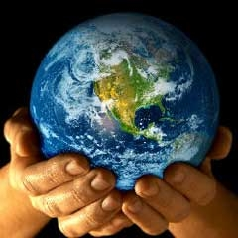
Environmental Health Think Tank
Amanda Alexander
Kate Belliston
Florence Fernandez
Michael Fong
Rosie Neville
Instructed by: Dr. Hans Ehrbar and Dr. Brian Moench

Slide 2
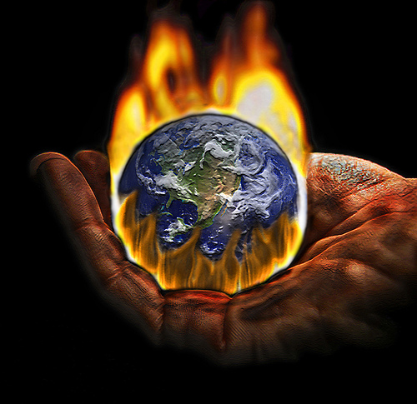
Climate Crisis
“We believe unequivocally that climate change presents an increasing risk to the world economy and social welfare.” – Swiss Re America
CO₂ concentrations are directly related to the temperature of the Earth.
Effects of Temperature Change
  1 degree C increase in temperature increases atmospheric water vapor by 7%
  Tropical mosquito borne diseases will migrate to higher altitudes and latitudes.
Global Warming in Utah
  Hotter with greater extremes
  Food Production
  Global Temperatures

Slide 3
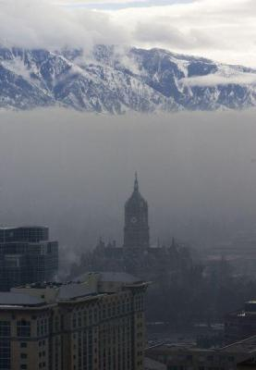
Air Pollution
Not just dust
  1gram = 1 billion organisms
Air pollution increases risk of lung cancer in Utah about 14 %.
Air pollution is not only harmful to our lungs, it affects every organ of our bodies.
  CO₂, Benzene, PM_{2.5}
  Lead and Mercury
Global emissions of CO2 increased 45 % between 1990 and 2010.
Effects of The Clean Air Act
  1978-1982 : 1.19 +/-0.27 years
  1997-2001 : 2.02 +/-0.50 years

Slide 4
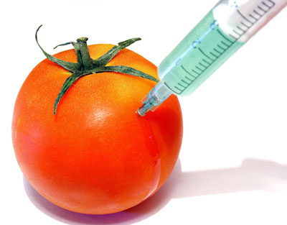
Genetically Modified Crops
What are GMOs?
As much as 80% of all packaged foods contain GMOs.
Potential Health Risks
Nutritional Costs

Slide 5

Radiation Exposure
There is absolutely no safe level of radiation exposure.
Radiation damage is cumulative.
Nuclear Accidents
In addition to nuclear catastrophes, low levels of nuclear radiation are released during every phase of the nuclear fuel cycle.
All nuclear plants release a steady stream of nuclear radiation into the atmosphere.

Slide 6
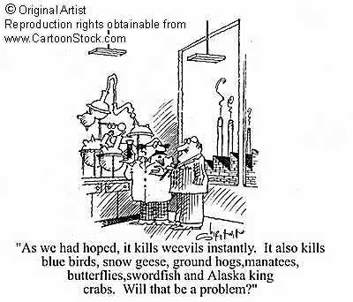
Chemical Exposure
      Mercury in the Great Salt Lake
Fetuses are exposed to all of the chemicals that their mothers have been exposed to and are already contaminated by them.
  1975-2002: 27.1% increase in childhood cancer
  287 chemicals
    180 known carcinogens

Slide 7
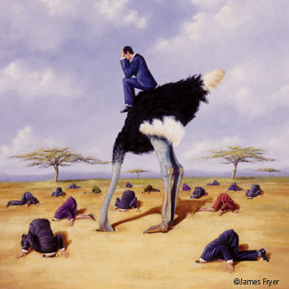
Climate Denial
What can we do?
Where does this leave us?

Slide 8
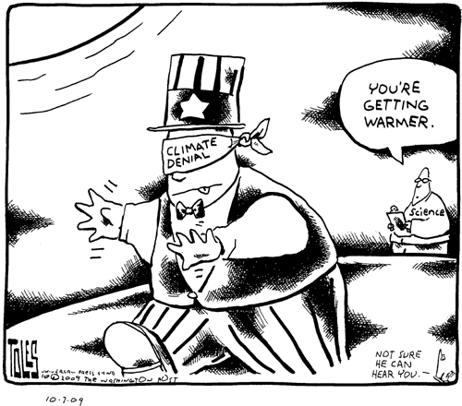
Responses to this Crisis
Individual
Community
State
Country
How do we live with this denial and take steps to alleviate these problems?
How can we educate the public without overwhelming them with information?

Slide 10
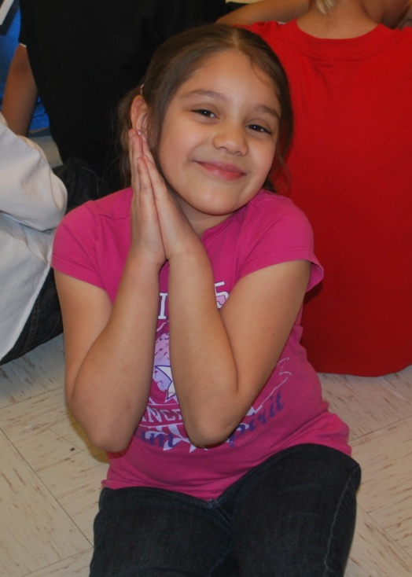
Why Healthy World, Healthy Home, and Healthy You
Our goal was to create a simple, age appropriate presentation to teach kids about ways to create a healthier world, home, and you.
  We chose to focus on children because we felt that this would enable us to give a good foundation for healthy and sustainable living, and would be a way to reach parents in a non-threatening manner.

Slide 11
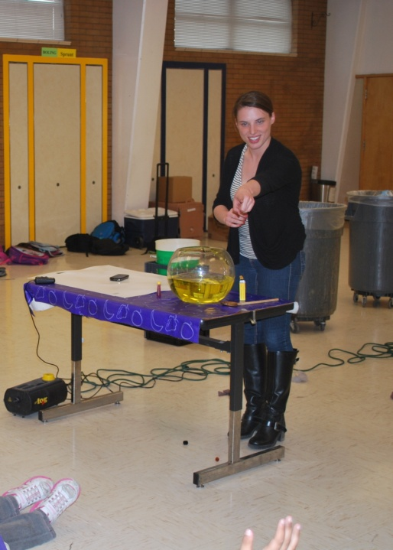
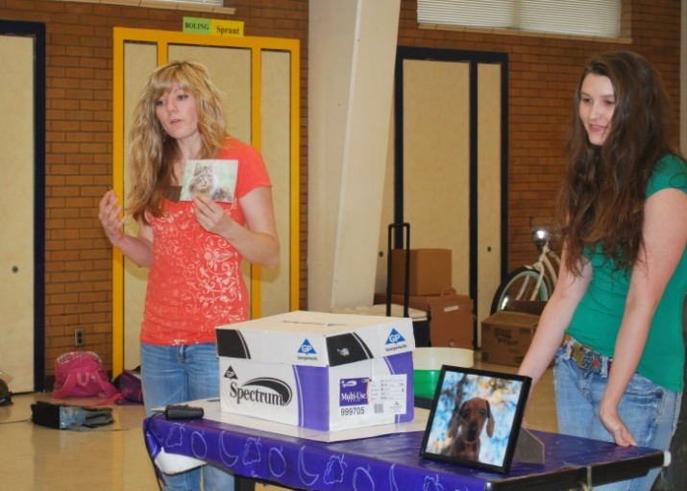
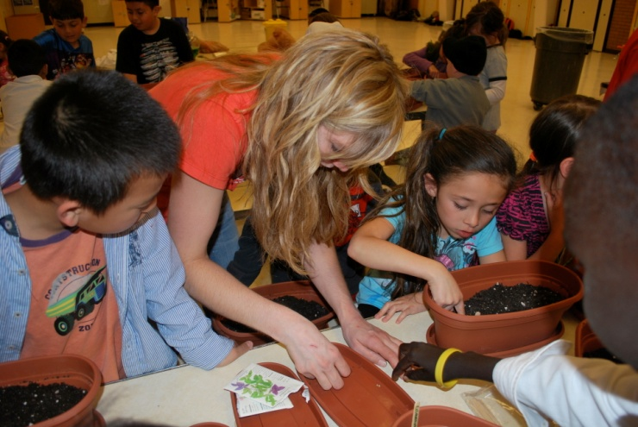
About our Project
Healthy World:
  Focused on ways to improve air quality in Utah, from no idling to carpooling and walking buses.
Health Home:
  Focused on using healthier and safer cleaning supplies.
Healthy You:
  Focused on highlighting the importance of healthy, less processed food choices and why they are better, combined with a take home activity.

Slide 12
Motivations
The world, the home, and you are all interconnected, everyday aspects of life.
By making a big problem tangible, we can empower kids to make a difference.
But, most importantly, we worked to give kids a way that they could have control over the world around them--we gave them something to do. Many of the suggestions we made are easy to implement, and can make a difference.

Slide 13
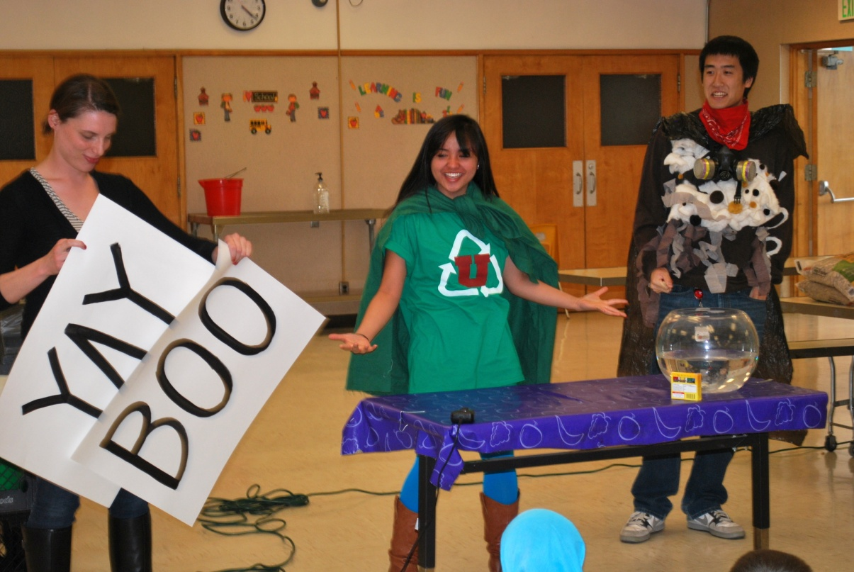
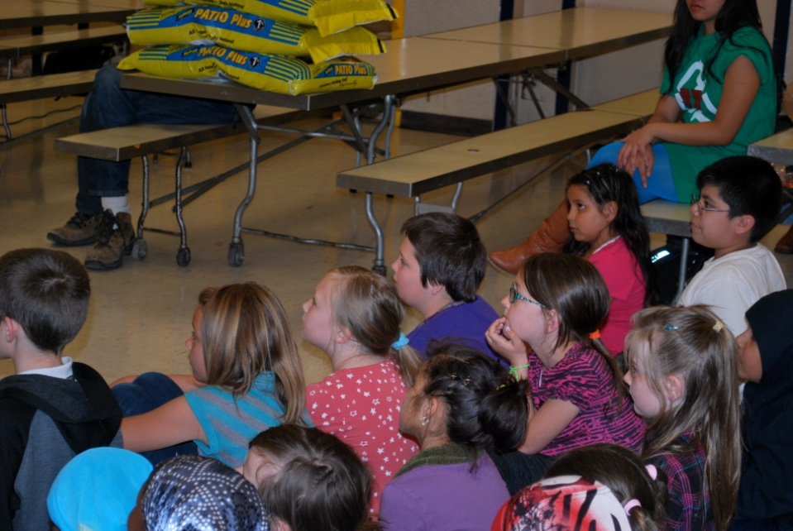
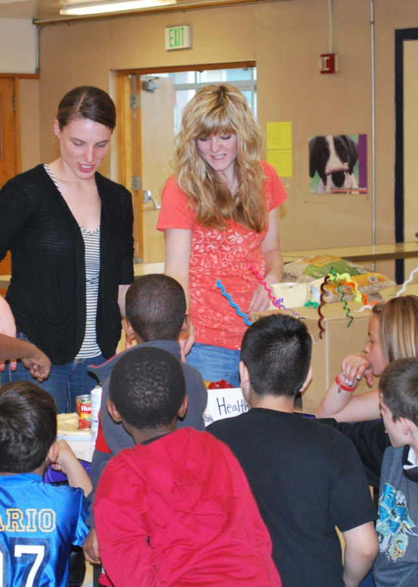
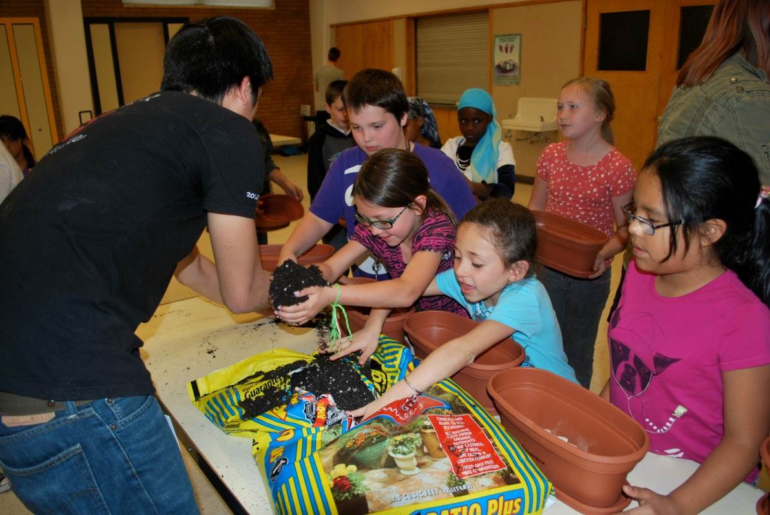

Slide 14
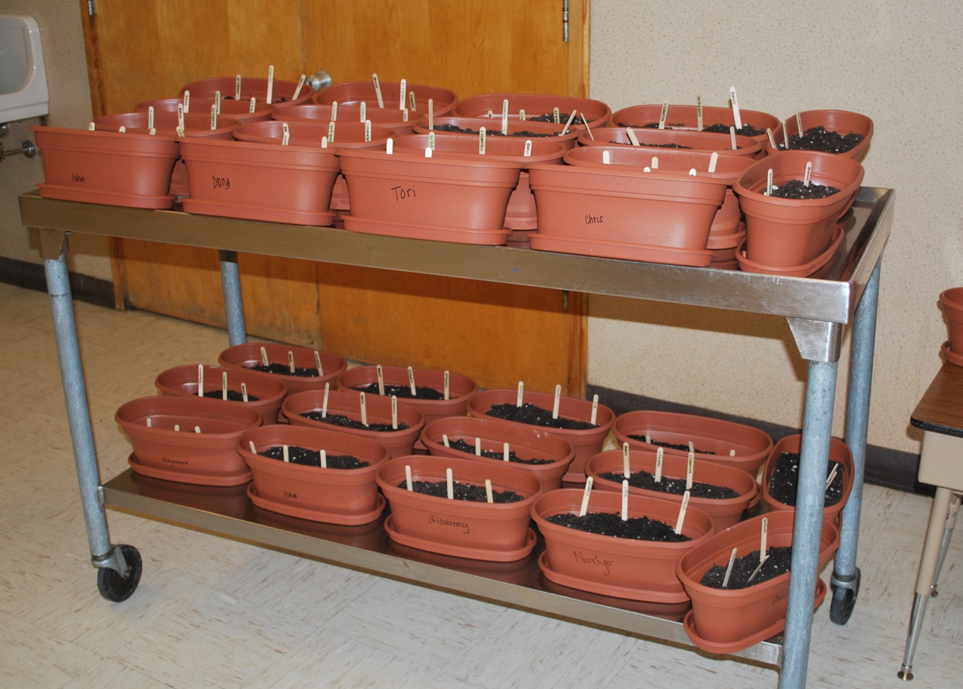
Impressions of the Project

Slide 15
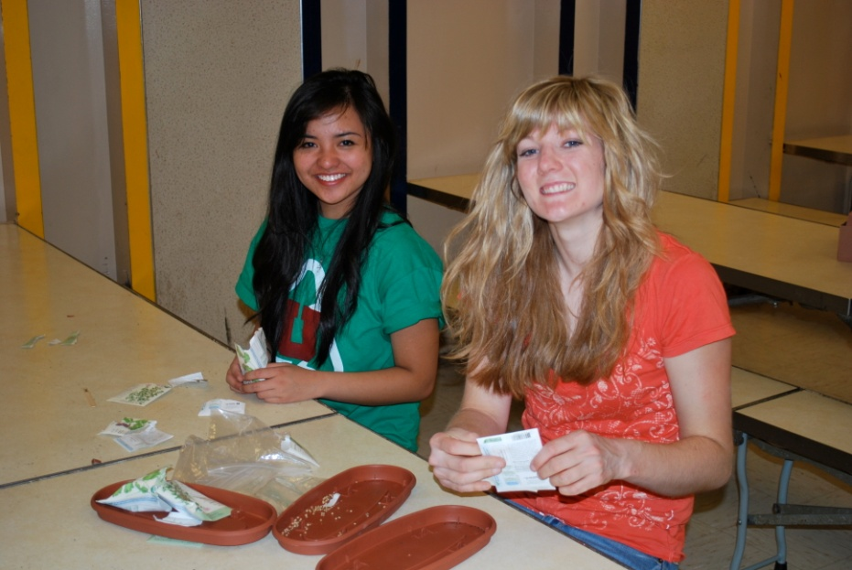
Healthy World, Healthy Home, Healthy You
Met the primary goal to introduce the issue to the students
Educated the students simple ways to protect themselves from air pollution
Was well received by the students

Slide 16
Project’s Weak Points
Time constraint
Effectiveness is not guaranteed
Issues at hand were drastically simplified

Slide 17
Potential Improvements
3 day presentation, each day dedicated to each issue
Inviting parents to observe the presentation

Slide 18
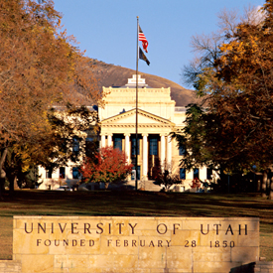
The University of Utah
Ranks 3rd in the nation for green power
Home to prominent climatologists
Access to latest technology, research and funding.
What does this amount to in the local community?

Slide 19

Future Role
Become an active leader and voice
Facilitator of student involvement

