Slide 1
Honors Praxis lab: redefining health and wellness
Presented by Alexis Lee
and Alexa Anderson and Shannon Weaver

Slide 2
outline
Lab Background
The 7 Dimensions of Health and Wellness
Health Manifesto
The Project - Thrive
Impacts
Sustainability
Q & A

Slide 3
Lab members and aspirations
Alexa Anderson – Biomedical Engineer
Stephanie Black – Medicine
Brett Cutler – Medicine
Andrea Evans – Nursing
Anderson Fackler – Medicine
Astin Goff – Nursing
Dane Goodwin – Artistic Entrepreneur
Alexis Lee – Public Health
Jennifer Nielsen – Registered Dietitian
Chaniece Pollock – Registered Dietitian
Lily Robb – Medicine
Shannon Weaver – Physician Assistant

Slide 4
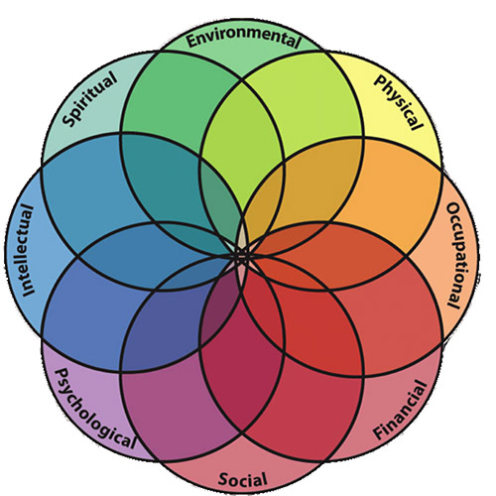
Why redefining health and wellness?
Health and wellness as traditionally defined
Health = physical body
Healthy behaviors = restrictive
Health and wellness redefined
Health and wellness = multidimensional
Healthful things = easy, exciting, and enjoyable

Slide 5
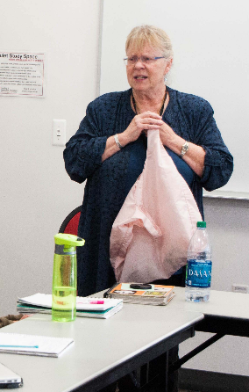
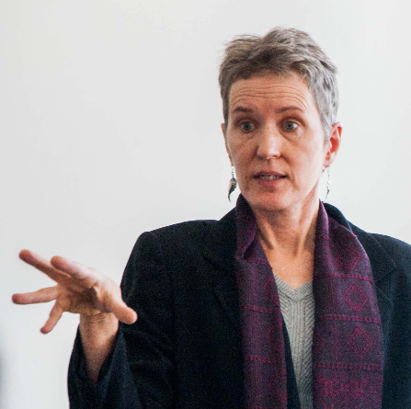
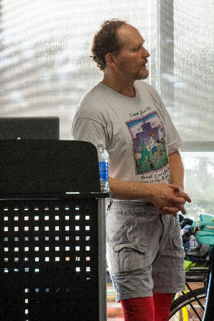
Health and Wellness Redefined
Sexual
Physical
Occupational
Environmental
Dr. Kirtly Jones helps us confront taboos of sexual health.
Visit to PEAK to investigate our physical health. Explored body composition and nutrition.
Dr. Yda Smith discusses benefits of occupational therapy in refugee population.
Dr. Moench presents environmental effects on health.

Slide 6
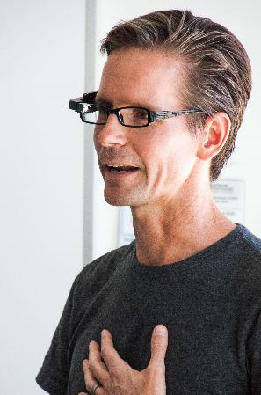
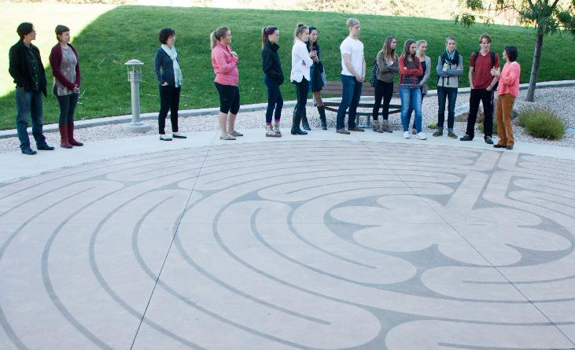
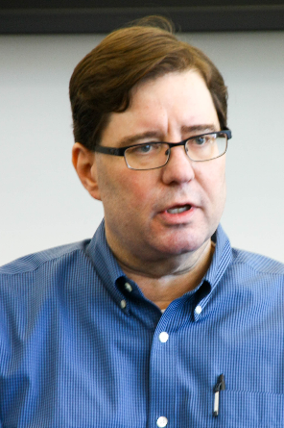
Health and wellness redefined
Social
Spiritual
Emotional
Dr. Rich Interdonato explains technology in social health.
Finding ourselves in the labyrinth on campus.
Dr. Jan Terpstra discusses emotional health of care providers.

Slide 7
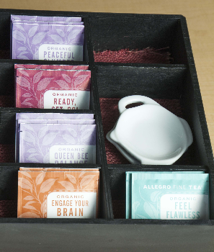
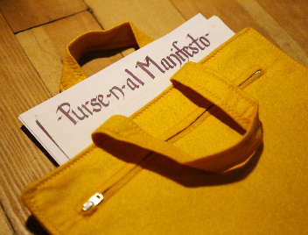
A manifesto for health
Seven dimensions + Guest speakers + Scientific literature
A challenge to define one’s values
A promise to one’s self
Declaration of healthy behaviors in the 7 dimensions
Life long change from single semester

Slide 8
Putting theory into action: the project
Multiple ideas presented
Community Garden, Therapy Animals, Life Planners, Continuing Sexual Education, Cooking Class
Evaluations by Fit, Impact, Sustainability, Achievability, and Passion
Class Vote
Winner: Cooking Class

Slide 9
Why cooking?
Wellness more than physical health, food more than nutrition
Food and food preparation impacts all dimensions of wellness
College students are:
Living independently
On a budget
Learning new skills
Cooking class impacts students’ health immediately & improves behaviors long term
Class may be continued for many future semesters

Slide 10
The timeline
January - vote and solidify cooking class topic
February - write curriculum, create cross-campus connections
March - begin 4 week pilot of cooking class
April - gather data from pilot and evaluate
May – August - solidify curriculum
August - begin 16 week Nutrition 1020 cooking lab
December - reassess and reformat as necessary

Slide 11
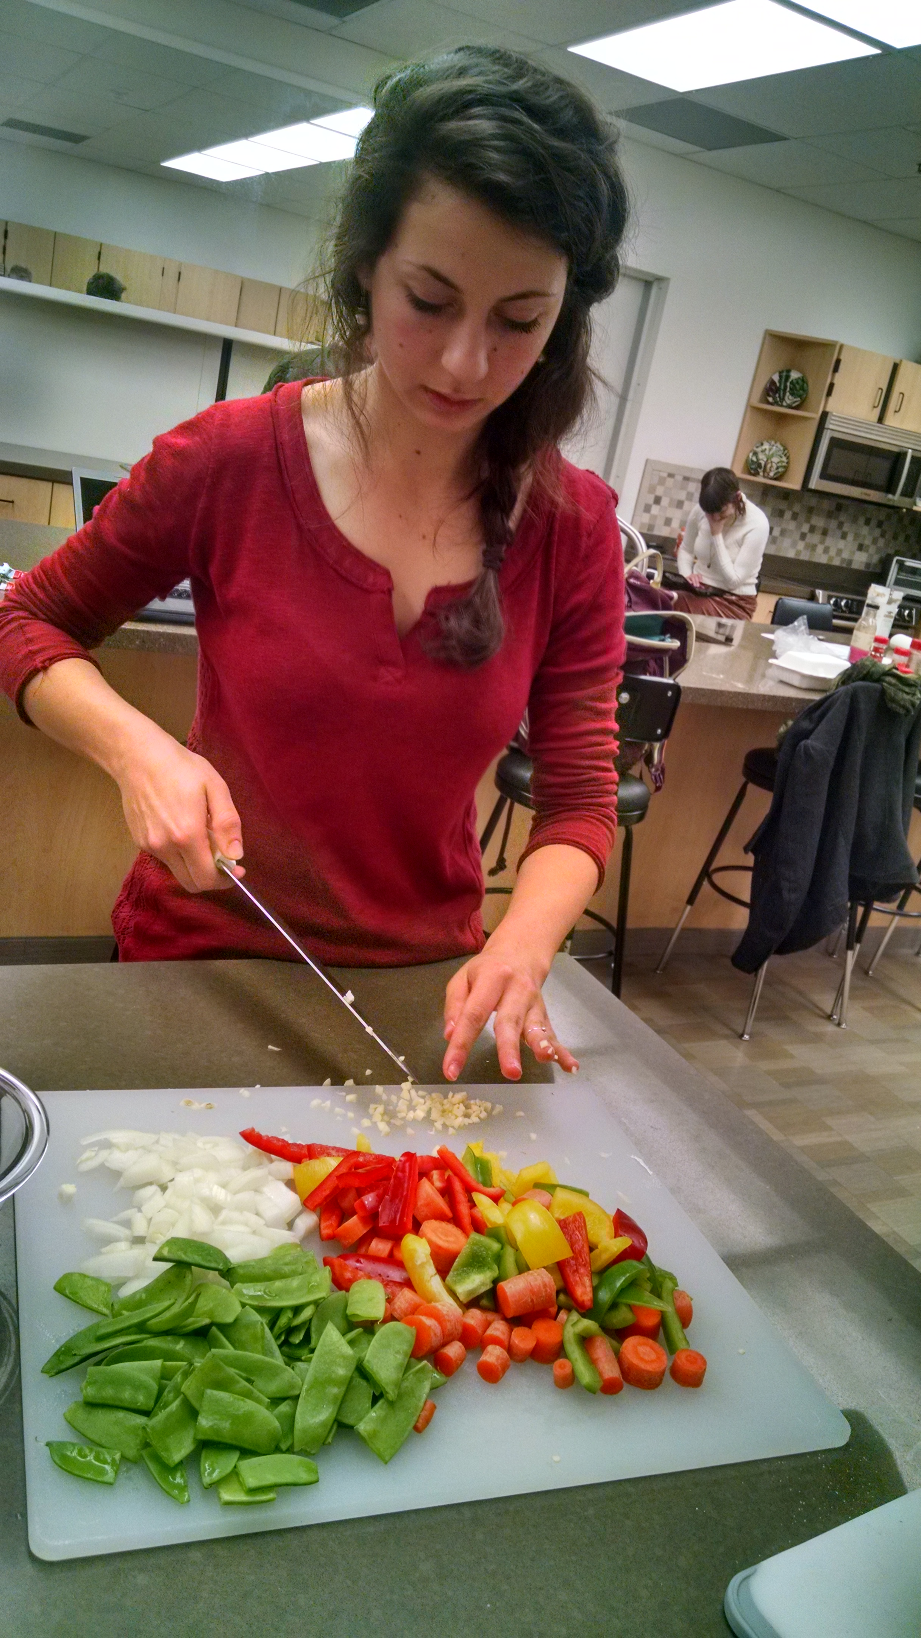
Thrive: the Pilot
Advertised to Nutrition 1020 Students
Four week pilot
15 participants, 3 instructors
Week 1: Basic cooking skills (chicken stir fry)
Week 2: Spiritual health (vegetarian pizza)
Week 3. Environmental health (risotto)
Week 4. Sexual health (spaghetti squash)

Slide 12
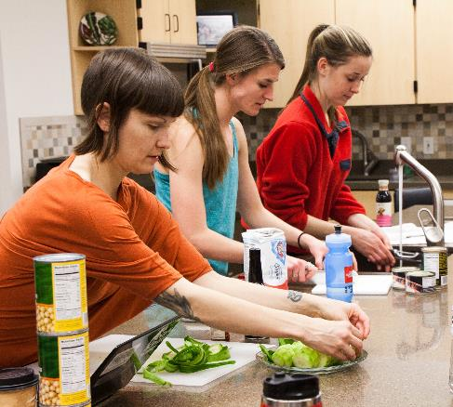
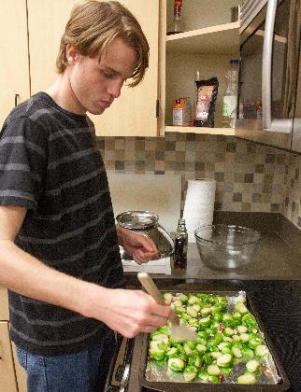
Pilot execution
Before and After surveys
Individual lesson and recipe feedback
Challenges:
Pilot attracted students with cooking skills
Dietary restrictions
Successes:
Students reported improvements in eating habits
Lesson feedback for fall semester lab

Slide 13
The impacts
Exploration of health and wellness through cooking
Provides new opportunity to learn life skills on campus
Improved food preparation skills and relationships to food
Development of cooking curriculum - an example to other college campuses

Slide 14
To be continued: project sustainability
4 week condensed pilot
16 week Nutrition 1020 lab
Lab will be monitored by 2 Praxis Team Members as Honors Theses
Foods donated to deserving community groups
Expansion of class as Nutrition elective or General Ed. Requirement

Slide 15
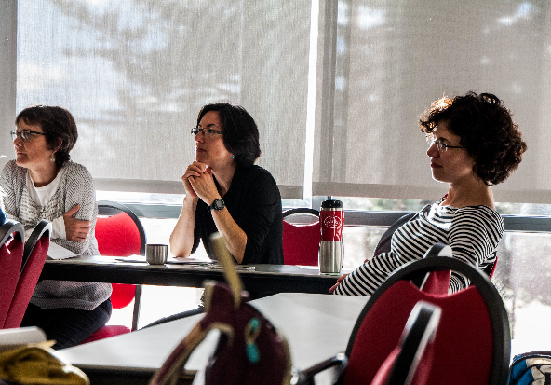
Acknowledgments
Kaiser Permanente
Honors College
Guest Speakers
Julie Metos, PhD, RD
Nikki Mihalopoulos, MD, MPH
Shannon Jones, MS
Praxis Team
All of you!
Notes:
Kaiser Permanente
Honors College
Guest Speakers
Julie Metos , Nikki Mihalopoulos, Shannon Jones
Praxis Team
All of you!

Slide 16
Questions?

